Slide 1

RNS Institute Of Technology
Channasandra, Dr. Vishnuvardana Road Bengaluru-560 098
Department of Information science
FS MINI PROJECT
SUBCODE : 18ISL67
“AIRLINE TICKETING SYSTEM"
BY
NAME : SHARANYA R P USN : 1RN20IS143
NAME : SIDHARTH S PAI USN : 1RN20IS160
Guided by : Dr. Nirmalkumar S Benni
Faculty In-charge : Dr. Prakasha S

Slide 2
CONTENTS
Introduction
About File structure
History of File structure
Project details
Results
Conclusions
Future Enhancement

Slide 3
INTRODUCTION
An airline ticket booking system is a software platform designed for online flight reservations.
It allows travelers to search, select, and purchase airline tickets conveniently over the internet.
Users can specify their desired departure and arrival dates, times, and destinations.
The system generates electronic tickets that serve as proof of purchase for passengers.
By streamlining the booking process, it saves time and effort for travelers.

Slide 4
ABOUT FILE STRUCTURES
File Structure is a combination of representations of data in files and operations for accessing the data. It allows applications to read, write and modify data.
It supports finding the data that matches some search criteria or reading through the data in some particular order.

Slide 5
HISTORY OF FILE STRUCTURES
Early work with files presumed that files were on tape, since most files were. Access was sequential and the cost of access grew in direct proportion to the size of the file.
As files grew intolerably large for unaided sequential access and as storage devices such as hard disks became available, indexes were added to files.
The indexes made it possible to keep a list of keys and pointers in a smaller file that could be searched more quickly. With key and pointer, the user had direct access to the large, primary file. But simple indexes had some of the same sequential flaws as the data file, and as the indexes grew, they too became difficult to manage, especially for dynamic files in which the set of keys changes.
In the early 1960’s, the idea of applying tree structures emerged. But trees can grow very unevenly as records are added and deleted, resulting in long searches requiring many disk accesses to find a record.
In 1963, researchers developed an elegant, self-adjusting binary tree structure, called AVL tree, for data in memory.

Slide 6
HISTORY OF FILE STRUCTURES
The problem was that, even with a balanced binary tree, dozens of accesses were required to find a record in even moderate sized files.
File indexing is a technique used to organize and manage large collections of files for efficient search and retrieval. It involves creating an index, which is a data structure that contains metadata about the files, such as their names, locations, attributes, and content information.
This index allows for quick and targeted access to files based on specific criteria or search queries.
With file indexing, the system builds and maintains a comprehensive index that catalogs the files present in a storage system. This index is typically stored separately from the actual files and is optimized for fast searching and retrieval operations.
It enables users to locate files by their names, types, dates, or even content keywords, without the need for manual scanning or browsing through directories.

Slide 7
FIELD AND RECORD STRUCTURE
The field and record structure of an airplane ticketing system includes essential components:
1. Passenger Name (Alphanumeric)
2. Flight Number (Alphanumeric or Numeric)
3. Departure Airport (Alphanumeric)
4. Destination Airport (Alphanumeric)
5. Departure Date and Time (Date and Time)
6. Arrival Date and Time (Date and Time)
7. Seat Number (Alphanumeric or Numeric)
8. Ticket Price (Numeric)
Each record represents a ticket and holds the above fields. These records are stored in a database for efficient management of ticketing information.

Slide 8
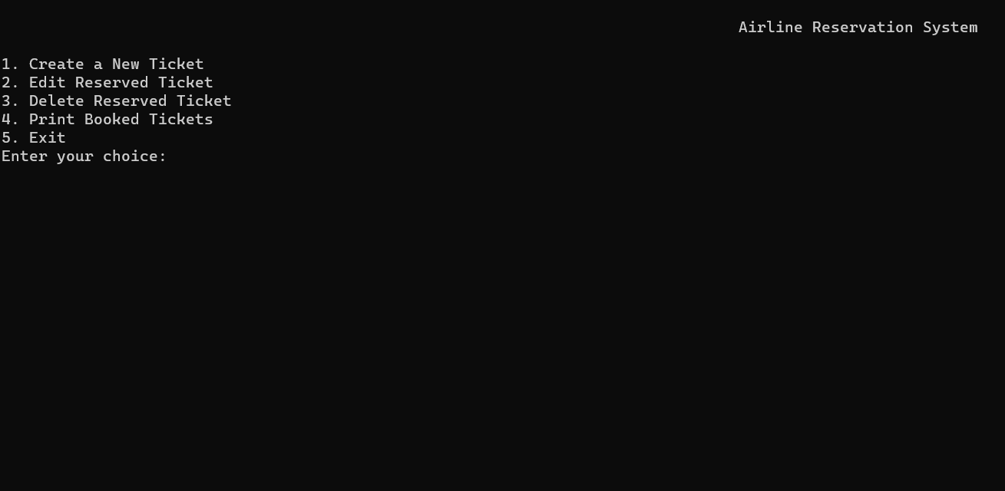
SNAPSHOTS
MENU OPTION

Slide 9
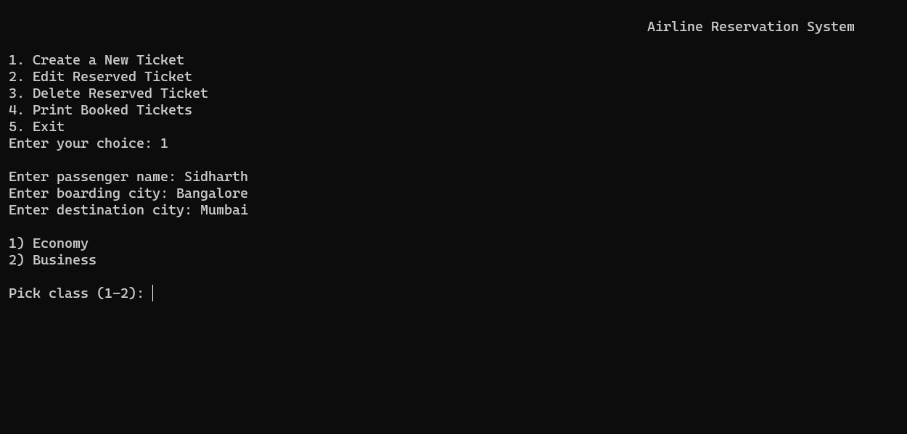
CREATE NEW TICKET

Slide 10
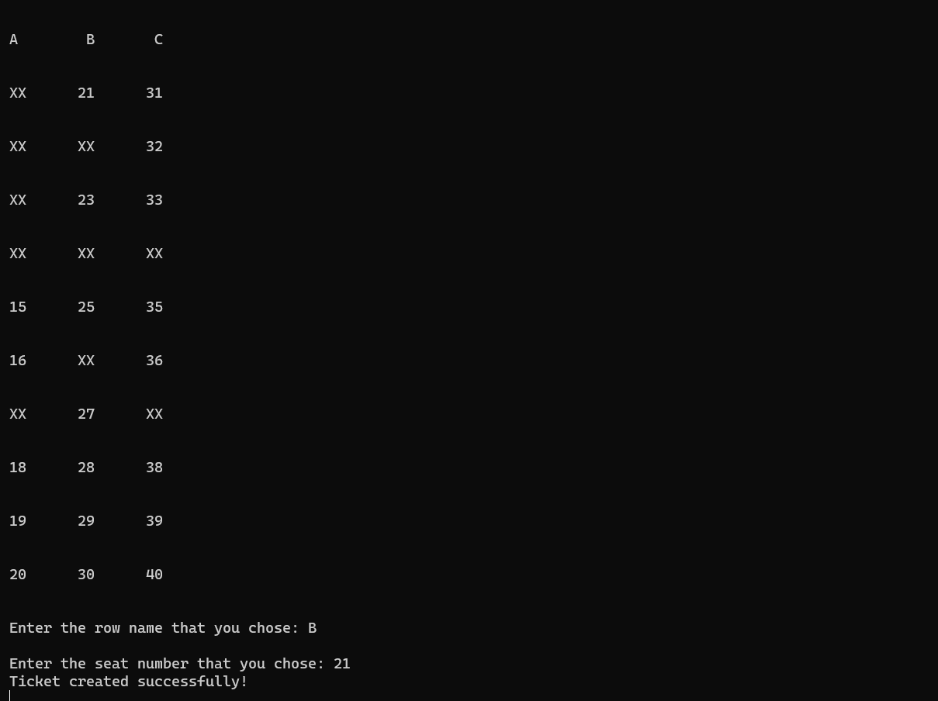
SEAT SELECTION

Slide 11
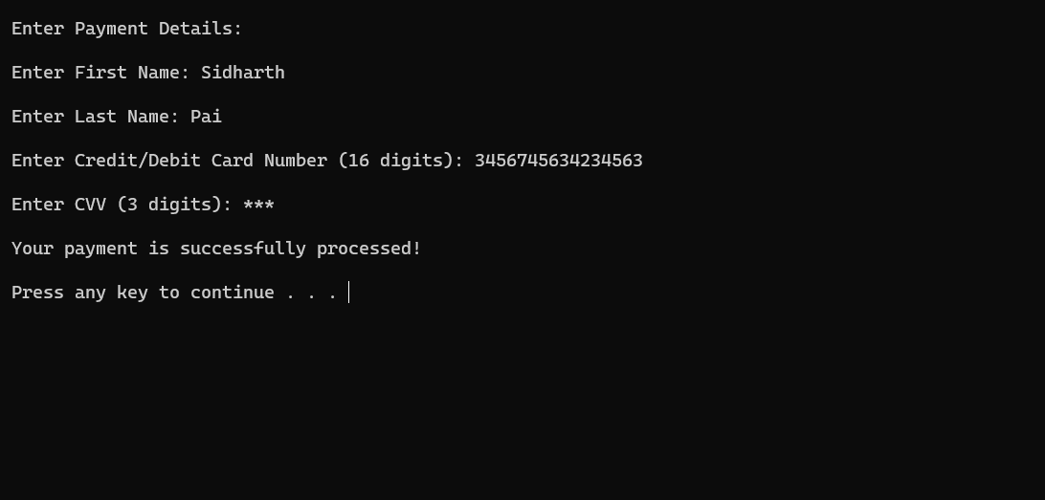
PAYMENT DETAILS

Slide 12
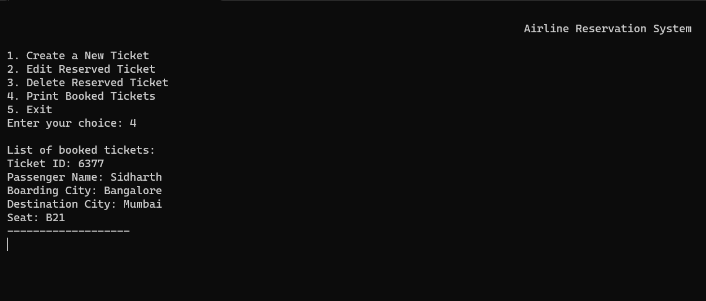
DISPLAY TICKET

Slide 13
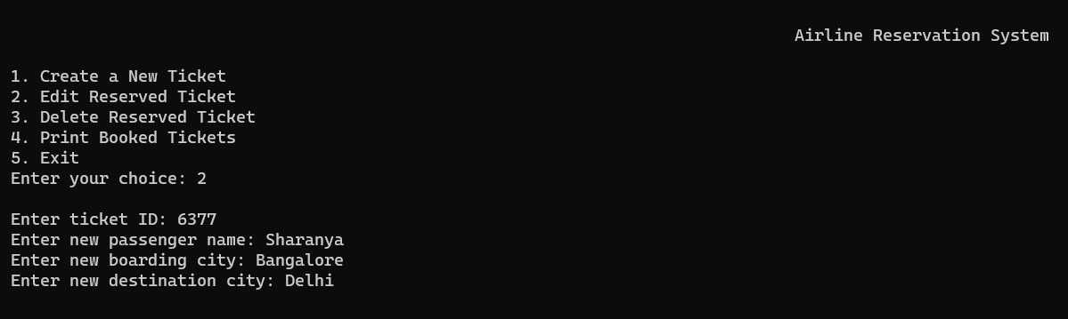
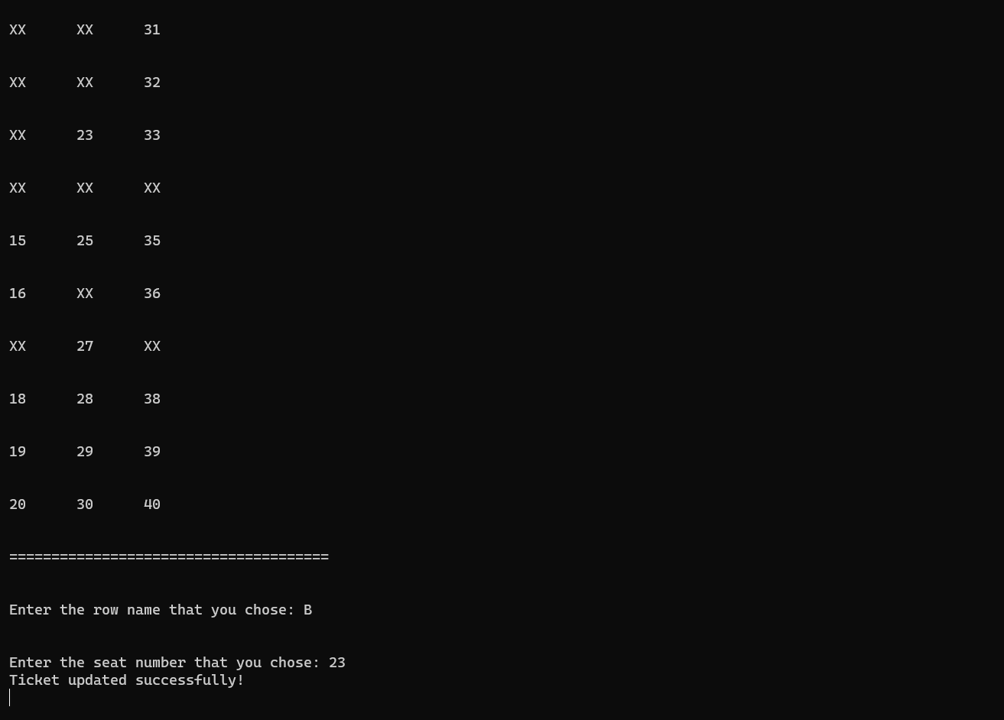
EDIT TICKET DETAILS

Slide 14
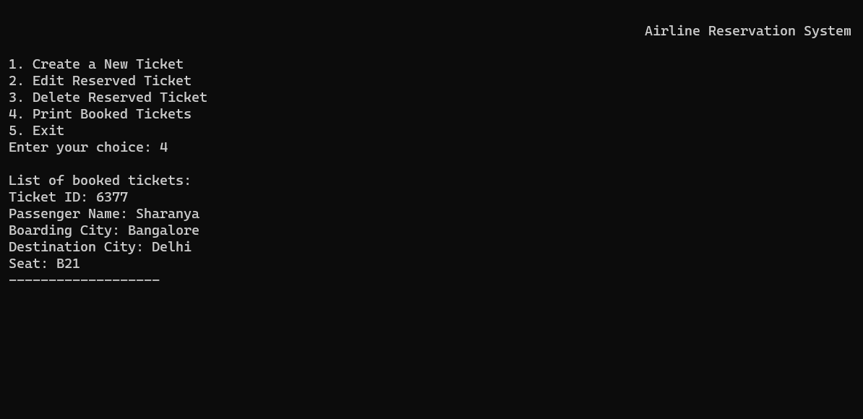
PRINT TICKET

Slide 15
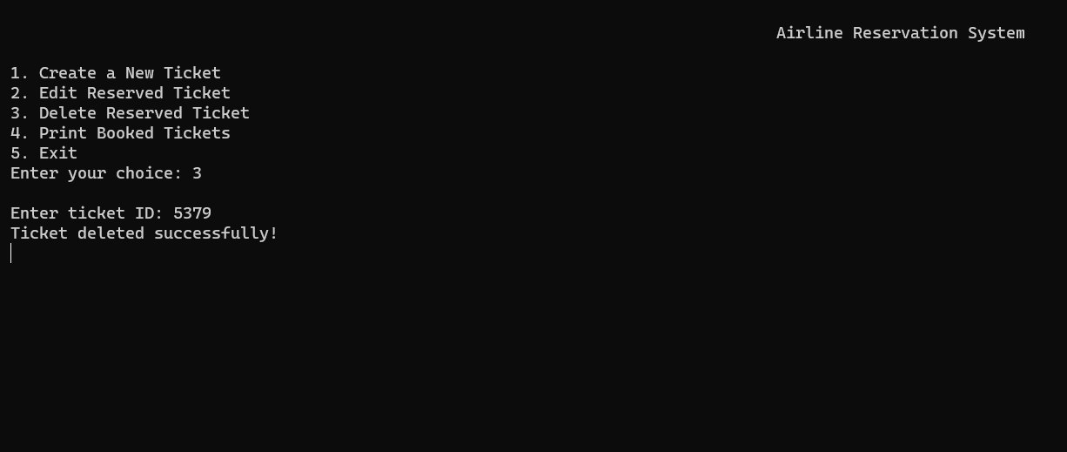
DELETE TICKET

Slide 16
APPLICATIONS
File structures in an airplane ticketing system have several important applications:
1. Efficient Data Storage: File structures enable the systematic organization and storage of ticketing data, ensuring easy access and retrieval of information when needed.
2. Transaction Processing: File structures facilitate transaction processing, allowing ticket bookings, cancellations, and modifications to be efficiently handled and recorded in the system.
3. Reservation Management: The file structures support the management of flight reservations, enabling the storage and retrieval of passenger information, flight details, and seat assignments.
4. Ticket Inventory Control: By using file structures, the ticketing system can maintain an accurate record of ticket availability, monitor seat occupancy, and manage ticket inventory effectively.

Slide 17
CONCLUSION
The project is a basic ticket booking system that includes user registration, login, and ticket creation features.
It focuses on user authentication and uses file handling to store and retrieve data. However, it's a simplified version and lacks advanced functionalities like seat selection and payment integration.
The project serves as a starting point for developing a more comprehensive system, with additional features and security measures required for a production-ready application.

Slide 18
FUTURE ENHANCEMENT
Additional features for the ticket booking system:
Email Notifications: Keep users informed about bookings with confirmation emails and updates.
Booking History & User Profiles: Enable users to view past reservations and manage personal information.
Social Media Integration: Allow users to share bookings and invite friends, increasing system visibility.
Multilingual Support: Make the system accessible to users from different language backgrounds.

Slide 19
THANK YOU!!

